Slide 1
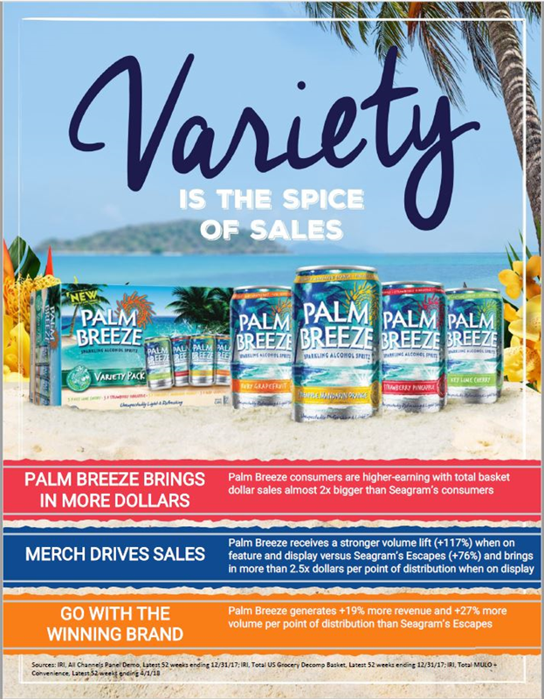
Grow More with Palm Breeze
Palm Breeze sales grew 15% in April, while Seagram's grew 1%
Palm Breeze sells faster
Dollar velocity is up 50% against year ago
Palm Breeze displays work harder for you
Lift on display grew 10% over year ago
Source: MULC 4-Weeks Ending 4/21/19
Notes:
Try to build a story from MULC only
Lift on Display is up 10% over year ago

